Slide 1
Programming in Alice 3.1
By Teddy Ward Under the direction of Professor Susan Rodger
July 2013

Slide 2
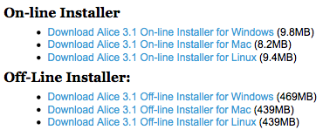
Download Alice 3.1!
You can get it at Alice.org
Click downloads > Get Alice 3.1
Select an installer for your operating system.

Slide 3
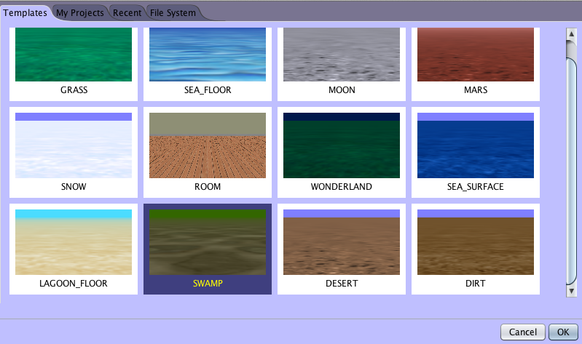
When you’ve got it running…
You’ll see a screen like this:
Select SWAMP (third row), then click OK

Slide 4
The Interface
v Scene View
Code Editor Panel
^ The Methods Panel

Slide 5
The Scene View
The scene view at the top left gives a view of our world.
Right now it’s just an empty swamp, but we’re about to add dragons, witches, and more!

Slide 6
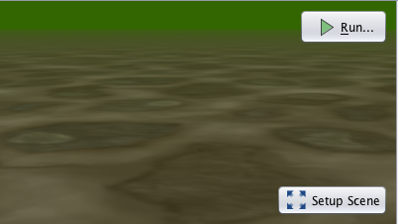
Making a Scene
Click on Setup Scene at the bottom right of the scene view to add objects to your scene.

Slide 7
Making a Scene
Now you’ll see the interface for adding objects
The scene view is still there, but now you’ll see a list of object galleries at the bottom
Objects are sorted by the way they move (flyers, swimmers, etc.), or by theme.

Slide 8
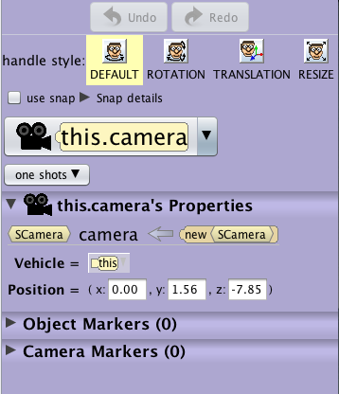
Making a Scene
There’s also a pane on the right that will let us move and change objects once we add them.
Move
Change

Slide 9
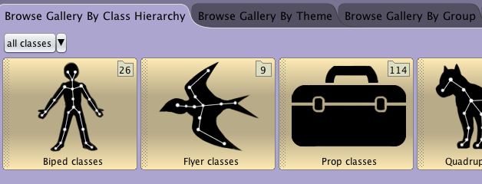
Making a Scene
Now, click the Browse Gallery By Theme tab above the list of galleries so we can add in a bunch of “fantasy” objects.

Slide 10
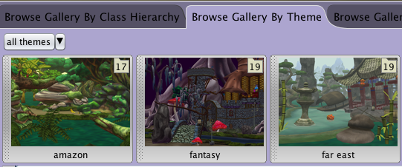
Making a Scene
You’ll see a list of themes of objects.
Note what’s here! You may end up wanting to make a world in, say, Wonderland later
Click fantasy for now.

Slide 11
Making a Scene
You’ll see a list of fantasy objects! Soon we’ll add a cauldron and dragons, but for now…
Scroll all the way to the right, to find our main character, the witch.

Slide 12
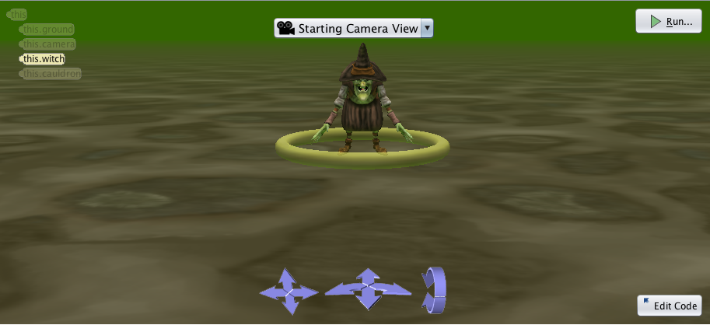
Making a scene
Click the witch, hold down your mouse, and drag her into the center of your scene view.
Select OK in the box that pops up

Slide 13
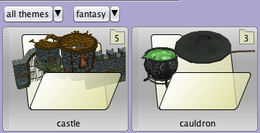
Making a Scene
Now we’ll give our witch a cauldron.
Scroll all the way to the right in the bottom pane, and select the cauldron folder.

Slide 14
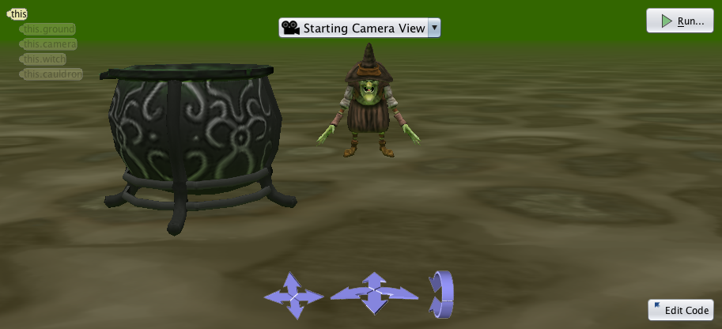
Making a Scene
Click and drag the cauldron in front and to the right of the witch.

Slide 15
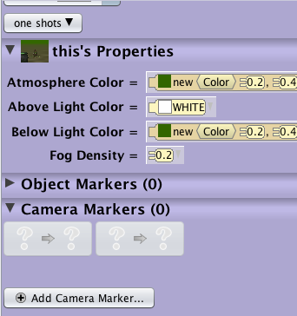
Like Spielburg
We want to save our camera position so we can move around without issue.
In the pane on the right, at the bottom, there’s a menu titled Camera Markers.
Click this.

Slide 16
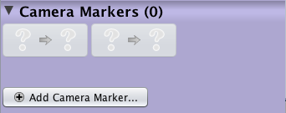
Like Spielburg
Camera markers are like tripods that we can drop in one place to save a view of the world. (In Alice 2.3, these were Dummy Cameras.)
Click + Add Camera Marker. A box will popup.
Type “START” in the name field, click OK.

Slide 17
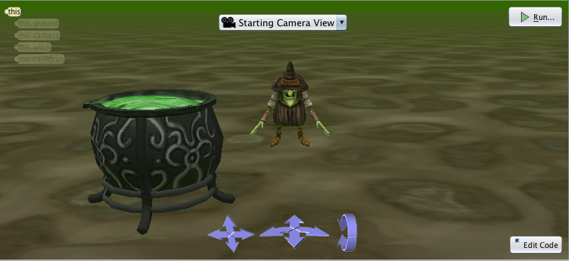
Like Spielburg
We’ll get back to Camera markers shortly.
We’re going to play with those blue arrows now so we can get a view of the potion:

Slide 18
Like Spielburg
The first set of arrows moves the camera up, down, left, and right
The second set moves the camera forwards and backwards and PANS (turns) it left and right
The final set turns the camera up and down.

Slide 19
Oops!
If/when things go wrong, there are undo and redo buttons in the top right that will certainly come in handy.

Slide 20
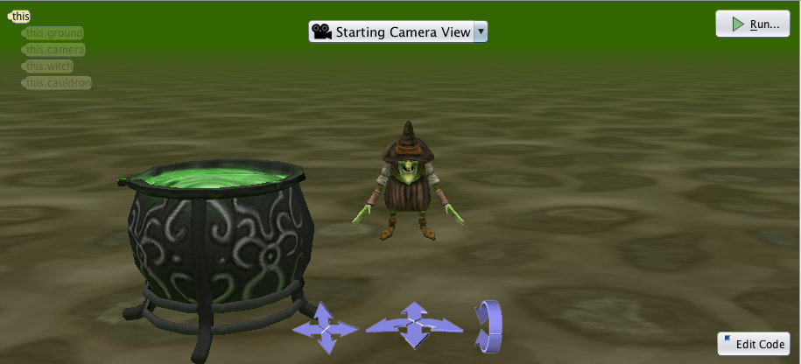
Like Spielburg
Tap the top arrow in the first group to move the camera up a bit.

Slide 21
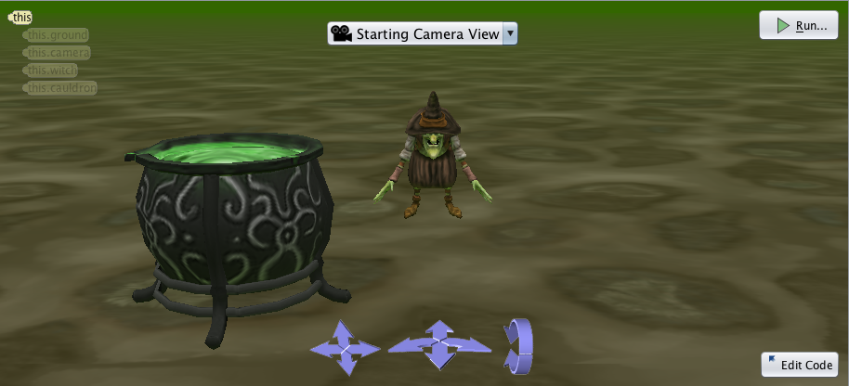
Like Spielburg
You can click the top arrow in the third group to rotate the camera down just a little bit.

Slide 22
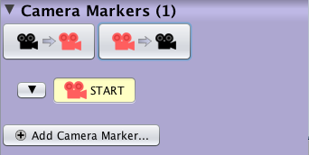
Like Spielburg
Now we’ll see how to switch between views.
+ Add Camera Marker on the right again, and name the second camera “betterSTART.”

Slide 23
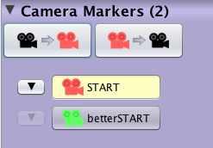
Like Spielburg
Now that there are two markers
If you select the original one (START), we can see how to quickly switch views.

Slide 24
Like Spielburg
The first button moves the camera to the marker you’ve selected (they’re color-coded!)
Try switching back and forth between views.
The second button moves the selected marker to the camera’s current view.

Slide 25
Like Spielburg
There’s also a dropdown menu at the top that will allow you to switch to a few preset camera markers.

Slide 26
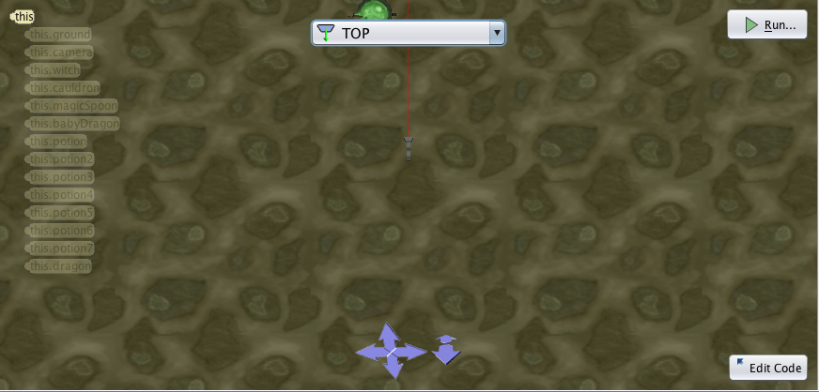
Like Spielburg
For example, choosing top view lets us see the world from above, with different controls.

Slide 27
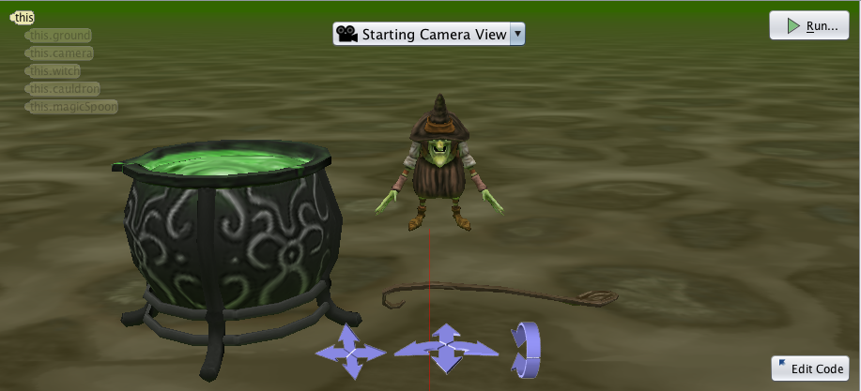
Properties & Placing Properly
Now we’ll learn a little more about objects.
Drag a MagicSpoon from the object gallery to the middle of the scene view.

Slide 28
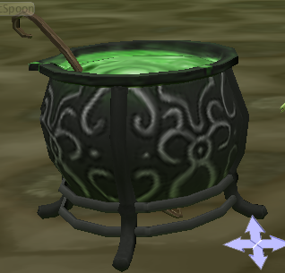
Properties & Placing Properly
We want the spoon in the cauldron as shown:
We’ll use the positional buttons in the upper right:

Slide 29
Properties & Placing Properly
There are four positional buttons.
DEFAULT moves objects around and turns them left and right.
ROTATION turns objects across all planes.
TRANSLATION shifts objects up and down, and side to side.
RESIZE makes objects bigger and smaller.

Slide 30
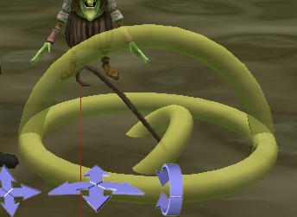
Properties & Placing Properly
Select the spoon, then click ROTATION.
three rings will surround the spoon as guides.
Click the top one and drag it so that the spoon is tilted like it would be if it were in the cauldron.

Slide 31
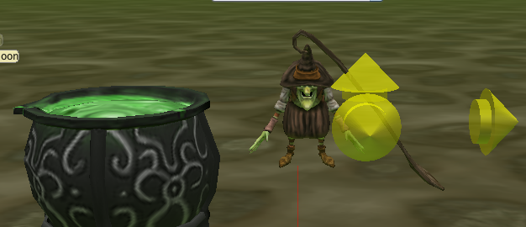
Properties & Placing Properly
Now click TRANSLATION, and three arrows will appear around the spoon.
Click the top arrow, and drag it up so that the handle of the spoon extends above the cauldron.

Slide 32
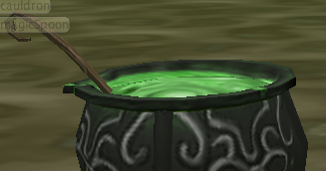
Properties & Placing Properly
Finally, click DEFAULT.
Click the SPOON (not the ring!) and drag it so that it leans against the left side of the cauldron.

Slide 33
Properties & Placing Properly
Finally, we’ll add in a baby dragon.
Click the fantasy dropdown above the list of objects to jump back to the fantasy folder:
We’ll drop a baby dragon in front of and to the left of the witch.

Slide 34
Properties & Placing Properly
Click the babyDragon icon, then click and drag whatever color you want so that it’s positioned as shown.

Slide 35
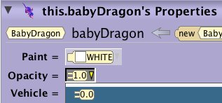
Properties & Placing Properly
We want our dragon to be invisible to start, so the witch can cast a spell to make it appear.
In “this.babyDragon’s Properties” pane on the right, find the Opacity dropdown.
If you change this from 1.0 to 0.0, the dragon will turn invisible!

Slide 36
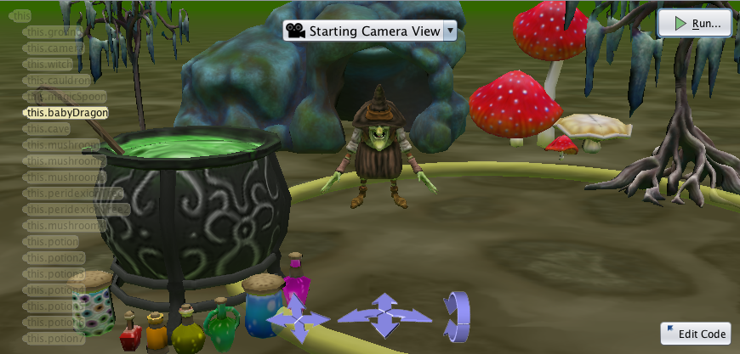
Programming in Alice
You can add more scenery to set the mood, if you want. I did just to make things more fun.
When you’re finished, click Edit Code.

Slide 37
The Interface
v Scene View
Code Editor Panel
^ The Methods Panel

Slide 38
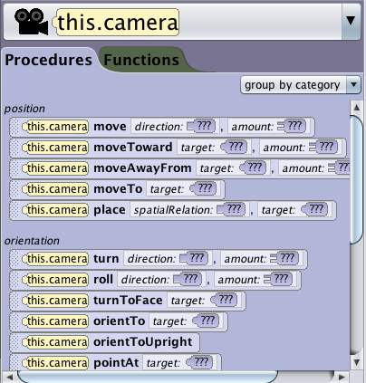
The Methods Panel
The Methods Panel shows us actions (or “methods”) that objects can do
Procedures are methods that make things move, turn, change color, etc.
Functions are methods that do calculations

Slide 39
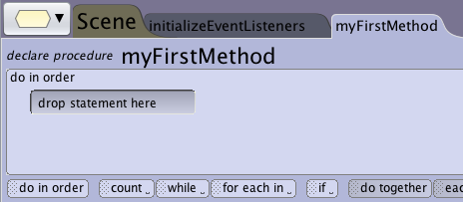
The Code Editor Panel
The code editor is where we program (!!!)
We drag in code from the methods panel to create multi-step custom procedures.
The tabs at the top are methods we can edit.

Slide 40
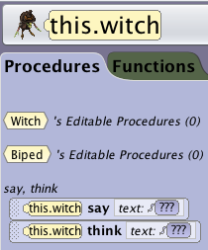
Double, double, toil and trouble
Code that we drop in the myFirstMethod tab will run whenever you press at the top right of the scene view.
Click on the witch in the scene view, and a list of procedures (actions) we can do with the witch will come up in the methods panel.

Slide 41
Double, double, toil and trouble
We’ll have the witch cast a spell.
Click and drag it into the code editor panel.
Select in the menu that comes up, and type “Double, double, toil and trouble!” (or your own spell!)
You now have code to make the witch say the spell!

Slide 42
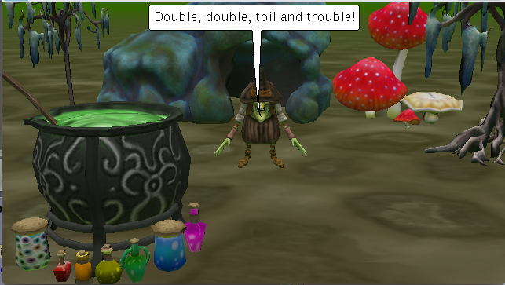
Double, double, toil and trouble
If you click at the top of the scene view, you can see your (simple) method in action!

Slide 43
Double, double, toil and trouble
We’ll stir the pot a bit (literally) to make things more exciting.
Click on the spoon in the scene view or select this.magicSpoon from the object dropdown which currently has this.witch selected:
Now, procedures (actions) we can do with the spoon will come up in the methods panel.

Slide 44
Double, double, toil and trouble
To make an object turn, we simply drag its turn method into the code editor panel.
You’ll have to scroll down to the the orientation-related methods to find it.
The “???”s indicate that Alice is going to ask us for a direction and an amount

Slide 45
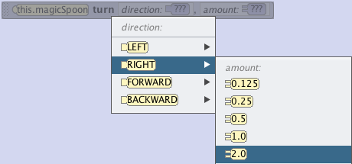
Double, double, toil and trouble
When you drag in this method, Alice will ask you for more information.
Select Right > 2.0.

Slide 46
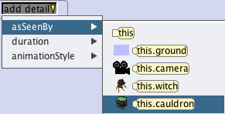
Double, double, toil and trouble
If you click now, the spoon will just spin around in place twice.
We want it to revolve around the pot instead
Select by your turn method call.
From the dropdown, select asSeenBy > this.cauldron.

Slide 47
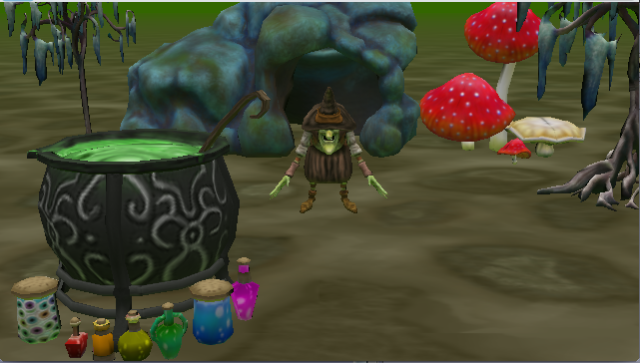
Double, double, toil and trouble
Now if you press the spoon will spin around twice in 1 second!
This is too fast, so we’ll click again…

Slide 48
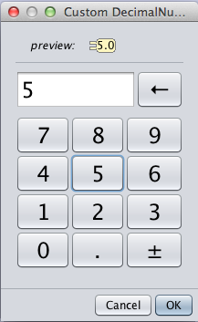
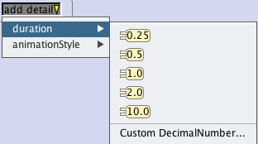
Double, double, toil and trouble
To slow it down, select duration > Custom DecimalNumber… in the dropdown.
A calculator will come up. Type 5.

Slide 49
Double, double, toil and trouble
Now the spoon will take 5 seconds to revolve!
If it doesn’t, try to copy my code below:

Slide 50
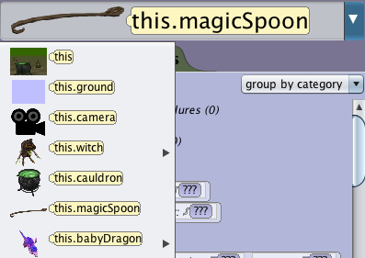
Heating up…
We’ll bring in an old friend; select this.babyDragon from the dropdown list of objects.

Slide 51
Heating up…
If you scroll down, under appearance you’ll find the setOpacity procedure:
Drag this into the code editor panel, and select 1.0 to make your babyDragon visible.

Slide 52
Heating up…
Now scroll all the way up in the methods panel, and under say, think you’ll find think.
Drag this to the bottom of myFirstMethod, select Custom TextString, and then type “Mama?” in the popup.

Slide 53
Heating up…
When you press play, your dragon should appear and think “mama?” If you’re having trouble, the complete code looks like this:

Slide 54
Procedural Celebration
Now that the witch has successfully conjured a dragon, she should celebrate.
We’ll create a new procedure to do so.
Writing our own procedures saves HUGE amounts of time, and will make our code much more organized and clear.
A sample procedure I created to make the dragon wag his tail.

Slide 55
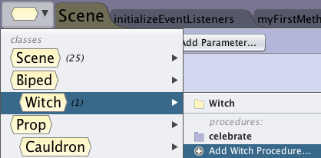
Procedural Celebration
To create a new procedure, click the button at the top left of the code editor panel.
Then select Witch > + Add Witch Procedure…
Call it “celebrate.” A blank procedure will open.

Slide 56
Procedural Celebration
Your scene view will now only show the witch. The witch is now referred to as “this.” “this” is Alice’s word for “the current object.”
We’ll have the witch scream “I AM INVINCIBLE!” and do a backflip!
First, drag in the witch’s say procedure.

Slide 57
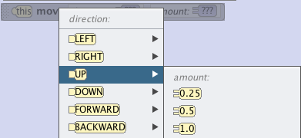
Procedural Celebration
There are three parts to a backflip: the jump up, the flip, and the landing.
Drag the witch’s move procedure into celebrate.
Select UP > 1.0 to make the witch jump up 1 meter

Slide 58
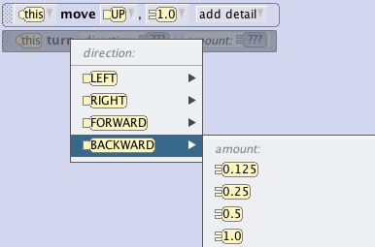
Procedural Celebration
We’ve done the jump, now we’ll do the flip.
Drag the witch’s turn procedure into celebrate.
Select BACKWARD > 1.0 for a full backflip.

Slide 59
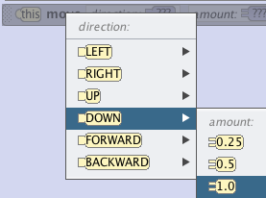
Procedural Celebration
Finally, the witch just has to land.
Drag the witch’s move procedure into celebrate.
Select Down > 1.0 to make the witch fall 1 meter.

Slide 60
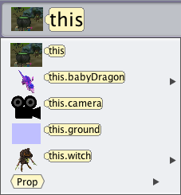
Procedural Celebration
Now select the myFirstMethod tab from the top of your code editor panel.
Reselect this.witch from the object list in the methods panel on the left.

Slide 61
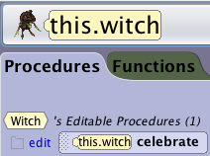
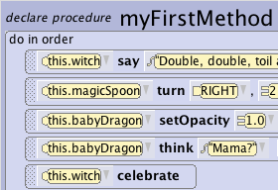
Procedural Celebration
You should see your new method this.witch celebrate under the editable procedures section of the witch’s methods.
Drag it to the bottom of the myFirstMethod procedure in the code editor panel.

Slide 62
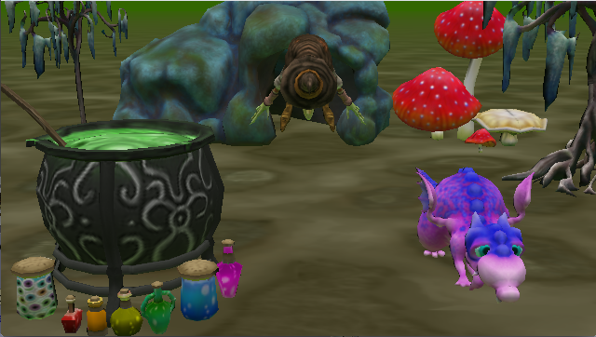
Procedural Celebration
Now if you press the witch will declare her invincibility and flip.

Slide 63
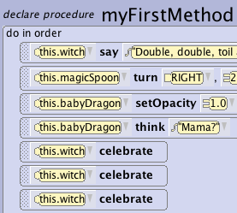
Procedural Celebration
To see the power of methods, try dragging three calls to celebrate into myFirstMethod.
If you press again, the witch will flip three times without you having to write any more code.

Slide 64
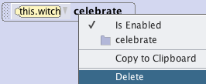
Procedural Celebration
Delete the last two calls to celebrate by right clicking and selecting delete.
We’ll learn another way to do this: find where it says count at the bottom of the code editor panel:

Slide 65
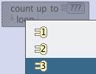
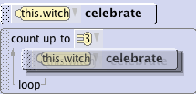
Procedural Celebration
Count is what we call a “loop:” it lets us execute the same code multiple times.
Drag it into myFirstMethod, and select 3.
Then drag the last celebrate line into the loop.

Slide 66
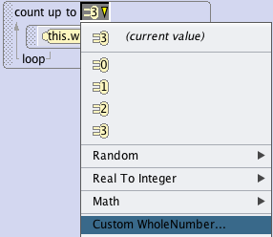
Procedural Celebration
When you press again, the witch will still flip three times.
When you press again, the witch will still flip three times. She’ll flip as many times as you tell her. Just change count up to 3 to Custom WholeNumber…
And she can flip virtually forever. Test this, but be sure to change it back to 3 afterwards.

Slide 67
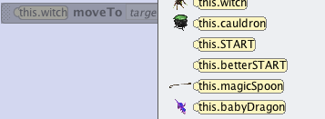
Gotta Getaway
We’re going to have the witch fly away on her dragon’s back.
Find moveTo in the witch’s list of procedures.
Drag it to the bottom of myFirstMethod and select this.babyDragon.

Slide 68
Gotta Getaway
Now drag in the witch’s say procedure, and type in “Let’s go ‘save’ the world, sweethang!”
When we program, we can make anyone a hero, even the witch ☺

Slide 69
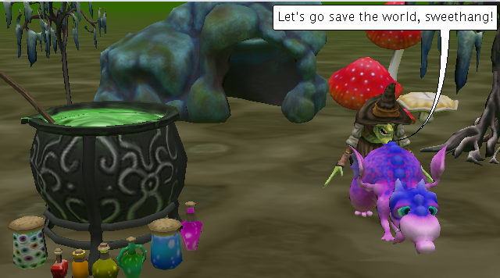
Gotta Getaway
When you click the witch will move to the dragon and then talk.
We want these things to happen at the same time, so find do together in that bottom row.

Slide 70
Gotta Getaway
Drag the do together into myFirstMethod.
We can drag multiple lines of code into the do together to execute them at the same time.
Drag in the last two: the moveto and the say.

Slide 71
Gotta Getaway
Now the witch will walk and talk at the same time!

Slide 72
Eventure Time!
We’ll make the dragon fly away when we press ‘F.’
To do so, we’ll write the shortest method ever.
Click in the upper left, then select BabyDragon > + Add BabyDragon Procedure…
Call the method “Fly”

Slide 73
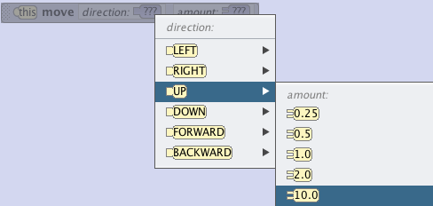
Eventure Time!
When the tab pops up, just drag in the babyDragon’s move method.
Select up > 10 meters. That’s it!

Slide 74
Eventure Time!
To make our method happen when we press ‘F,’ we’ll use what we call an event.
Click the initializeEventListeners tab at the top of the code editor panel.

Slide 75
Eventure Time!
Here you will see a mysterious block of code.
Events tell the program WHEN to execute code.
This code means that when we press run, the program executes myFirstMethod.

Slide 76
Eventure Time!
To make a new event, select Add Event Listener v > Keyboard > addKeyPressListener.
You’ll see your new keyPressed event, but right now it doesn’t do anything. We’ll change that.

Slide 77
Eventure Time!
We want the event to execute if we press ‘F’ so drag where it says if at the bottom of the screen to the conveniently-named drop statement here part of your event.

Slide 78
Eventure Time!
This block says IF something is true (ie: if ‘F’ was pressed), then execute the code in the first section. ELSE (if it wasn’t ‘F’), execute the second section.
Drag where it says e isKey key: ??? over where it says true, and select letters (A-Z) > F.

Slide 79
Eventure Time!
Now things make slightly more sense…
If the key we pressed (“e”) was ‘F,’ then we’ll do the first <drop statement here> blank.
So all we have to do is change <drop statement here> to our fly procedure.

Slide 80
Eventure Time!
Select this.babyDragon from the list of objects on the left.
Your fly procedure will be in the top group, locate it.

Slide 81
Eventure Time!
Drag this.babyDragon fly into the top part of the if statement.
Now if the key we press is ‘F,’ the dragon flies. Otherwise, nothing happens.

Slide 82
Eventure Time!
Now, if you click inside the window while the program is running (a necessary step), then press ‘F,’ the dragon will fly.
This will happen whenever you press F, but the user won’t know to do it until he/she is told.
Right now, the dragon will ditch the witch.

Slide 83
Planes, Trains, and Dragons
We moved the witch to the dragon, but we didn’t tell her to ride the dragon.
To do so, we’ll use a vehicle.
Switch back to the myFirstMethod procedure tab!

Slide 84
Planes, Trains, and Dragons
Select this.witch in your list of objects.
She (like all objects) has a procedure called setVehicle towards the bottom. Locate it.

Slide 85
Planes, Trains, and Dragons
Drag the setVehicle procedure into the doTogether at the bottom of myFirstMethod.
Select this.babyDragon.
Setting a vehicle makes one object ride the other; in this case, the witch rides the dragon.

Slide 86
Planes, Trains, and Dragons
We should also never forget to give our users instructions, so make the dragon think “Press ‘F’ to make me fly!” after the do together.
You’ll have to select dragon in the object list, and then his think procedure.

Slide 87
Fin
Here’s the “final” code from myFirstMethod:

Slide 88
Here’s the code from witch celebrate:
And from our event:

Slide 89
The witch flies away to save the world, so we’re done, right?? Well, sorta.

Slide 90
Extensions
We’ve gone through a lot of tough concepts really fast: asSeenBy, loops, conditionals, events…
These take college students weeks to learn. You might have done it in an hour.
So…
PRACTICE!
Elaborate on this story! Create new stories! Make Martians crash land on Earth. Make a troll attack a castle. Have a coyote discover buried treasure in the desert. Make a fat cat eat food. Make an explorer encounter a yeti in the arctic…

Slide 91
Extensions
To start: extend this project.
Try making the witch do a dance!
Add in an adult dragon! Change camera views!

Slide 92
Extensions
Find out how to use functions!
If you get confused, consult the how-to guide:
http://www.alice.org/3.1/Materials/UserGuide_PDF_Complete.pdf

