Slide 1
Creating a UFO Rescue Game in Alice
Project Rise-Up
Georgia Institute of Technology

Slide 2
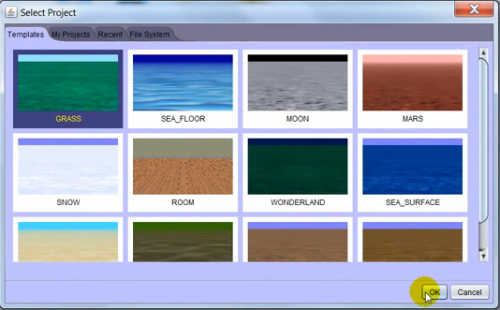
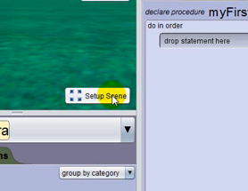
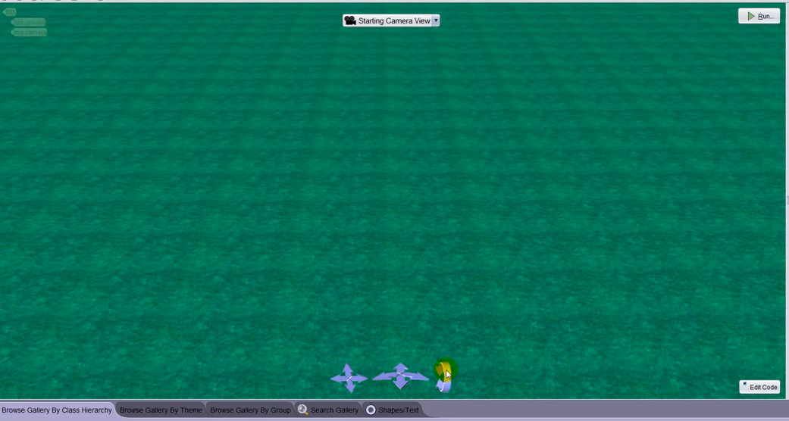
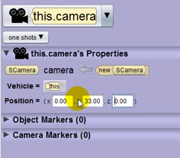
Step 1: Starting the Tutorial &
Setting Up the Scene
1. Open Alice
2. Select the Grass template, then click OK
3. Click the Scene Setup button
4. Go to this.camera
5. Set X = “0” and Z = “0”
6. Set Y = “33”
7. Turn the camera to face the ground

Slide 3
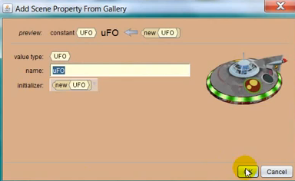
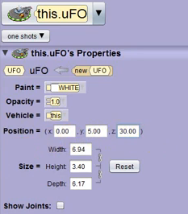
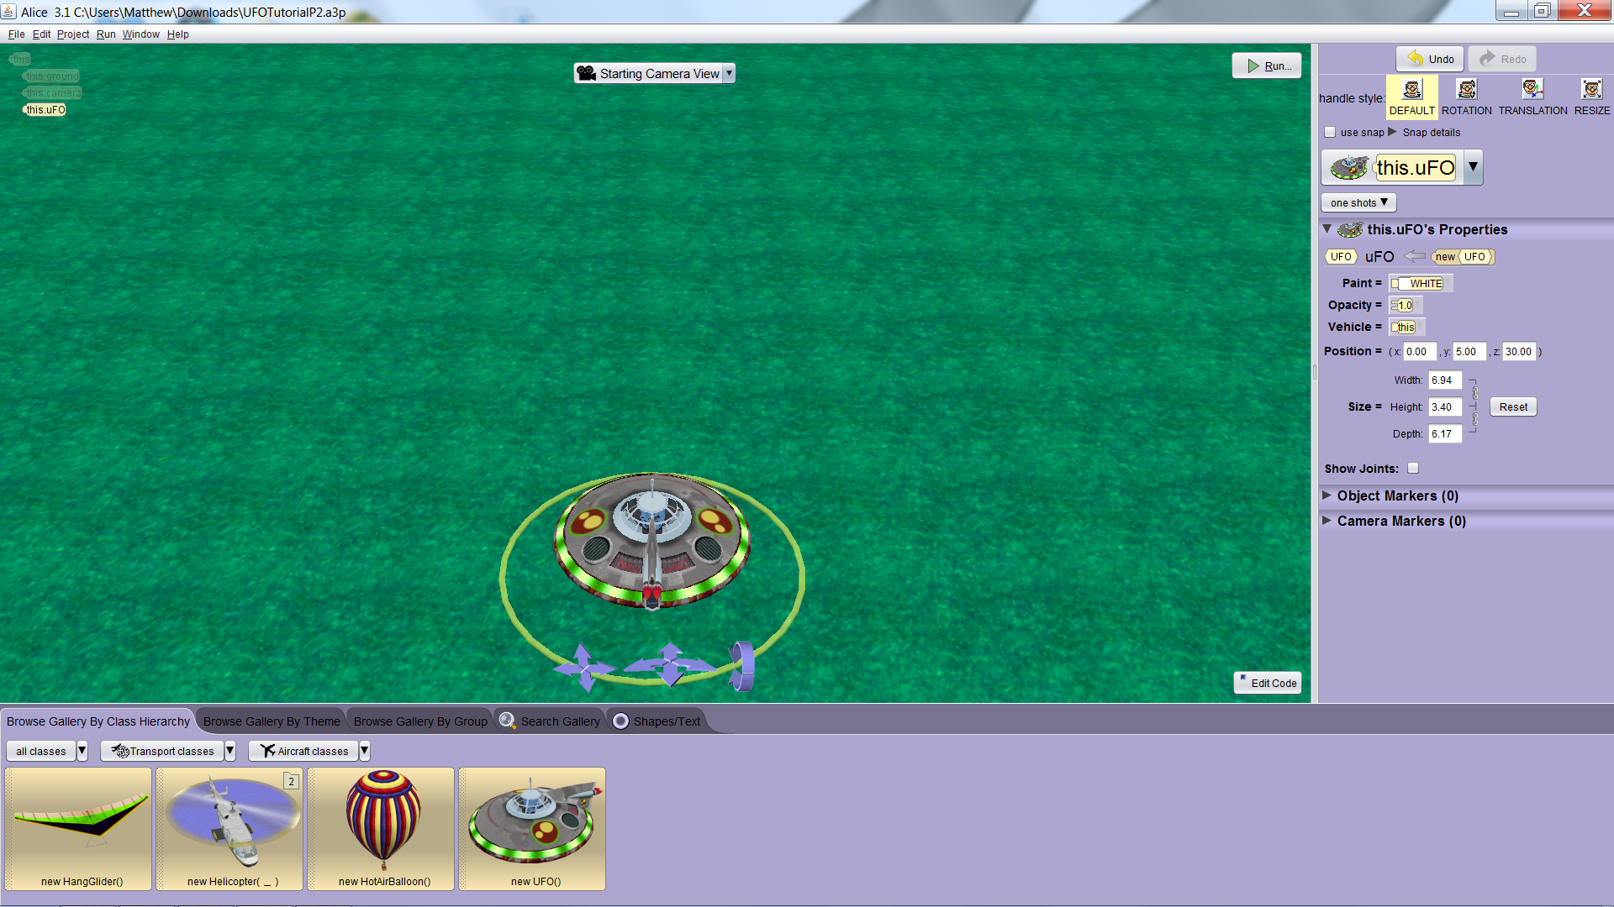
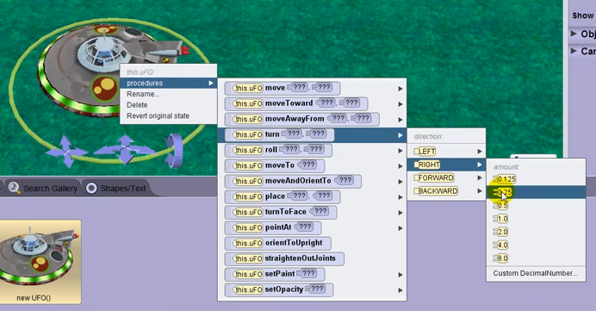
Step 2: Creating & Orienting
the UFO
1. Click on Transport Classes
2. Click on Aircraft Classes
3. Drag the UFO object into the scene
and call it “UFO”
4. Go to this.UFO
5. Set X = “0”, Y = “5”, and Z = “30”
6. Add the procedure “turnRight 0.25”

Slide 4
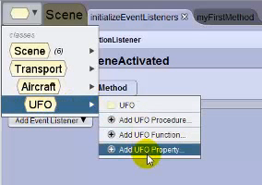
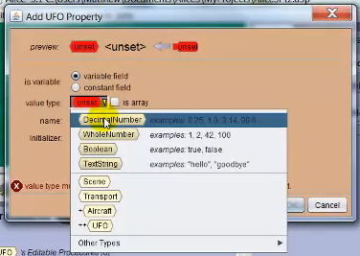
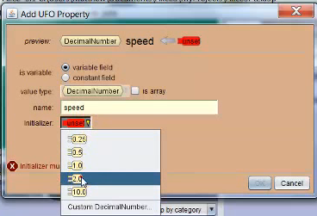
Step 3: Moving Forwards & Backwards -
Creating Variables
1. Click Edit Code
2. Click the Classes box and mouse over
UFO
3. Click Add UFO Property
4. Create a variable named “speed” and
make it a DecimalValue
5. Set this variable to “2.0”

Slide 5
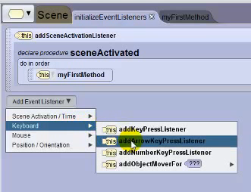
Step 3: Moving Forwards & Backwards -
Creating Event Listeners
1. Click on InitializeEventListeners
2. Click Add Event Listener
3. Choose “Arrow Key Pressed Listener”

Slide 6
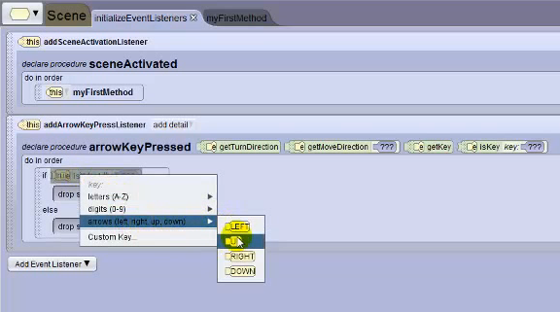
Step 3: Moving Forwards & Backwards -
Conditional Statement
1. Add an if statement to arrowKeyPressedListener
2. Click isKey
3. Select arrows
4. Select UP

Slide 7
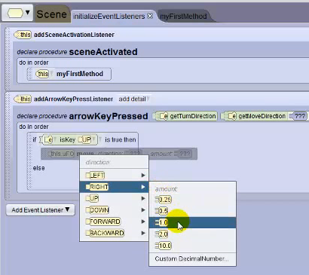
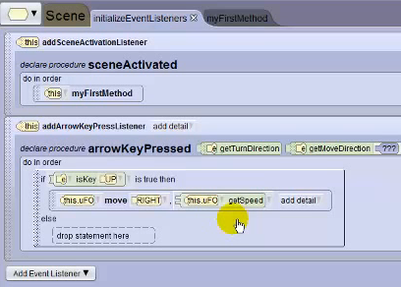
Step 3: Moving Forwards & Backwards - Input
1. Go to this.UFO’s procedures
2. Put the move procedure in drop statement here under isKey
3. Set to RIGHT and “1.0”
4. Drag getSpeed and put it in the speed value place for move
5. Click on move’s details
6. Go to animation style and choose begin and end abruptly

Slide 8
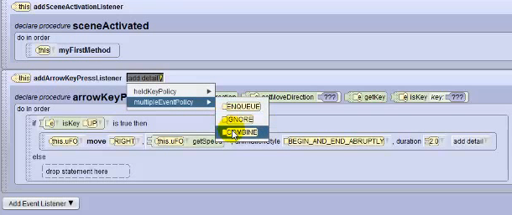
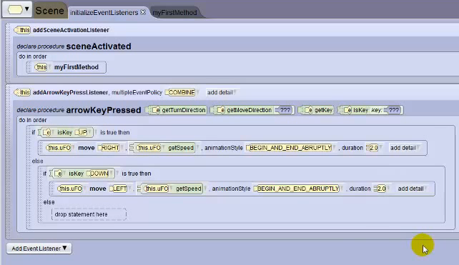
Step 3: Moving Forwards & Backwards - Input (cont.)
7. Click on details again
8. Choose duration and set it to “2.0”
9. Go to arrowKeyPressedListener and choose details
10. Choose multiple event policy
11. Choose combine

Slide 9
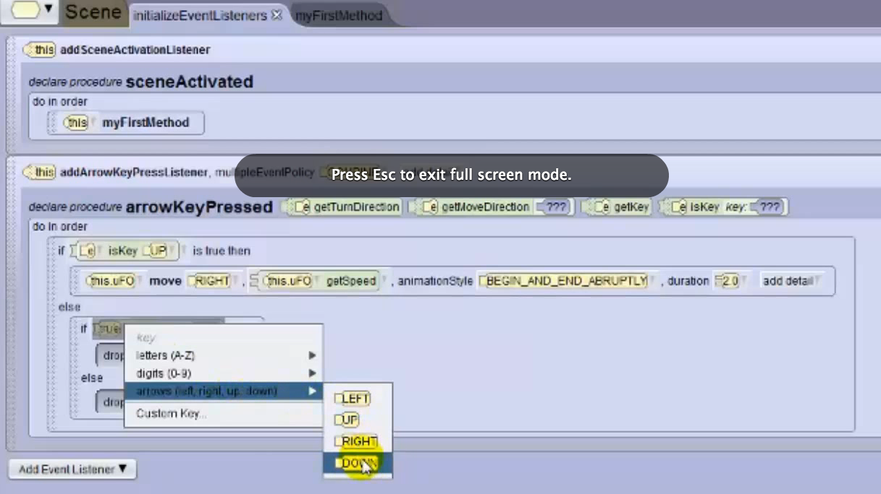
Step 3: Moving Forwards & Backwards - Input
1. Drag another if statement to the else section
2. Set to true
3. Choose isKey from arrowKeyPressed
4. Select arrows
5. Select DOWN

Slide 10
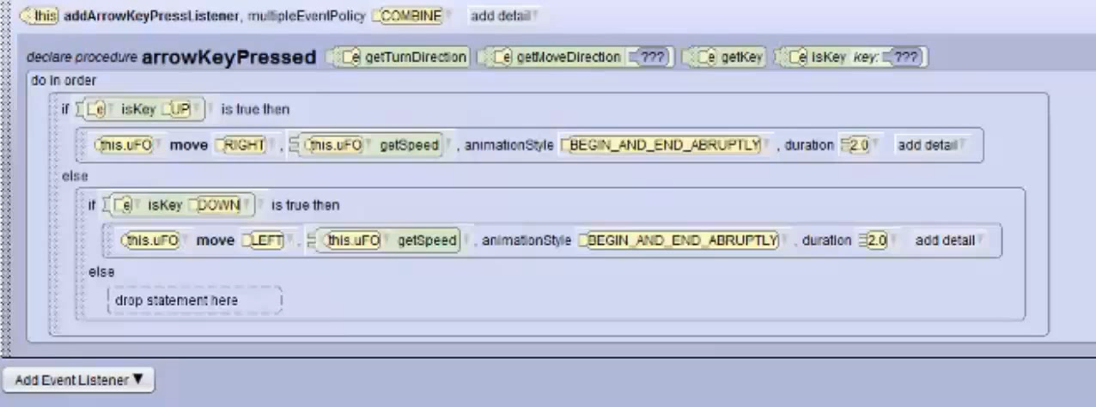
Step 3: Moving Forwards & Backwards - Moving Backwards
1. Go to the procedures for this.UFO
2. Drag the move procedure into drop statement here under isKey
3. Set to LEFT
4. Drag this.UFO’s getSpeed function onto the speed value
5. Click on the move procedure’s details
6. Go to animation style and choose begin and end abruptly
7. Go to move’s details again
8. Choose duration, then 2.0

Slide 11
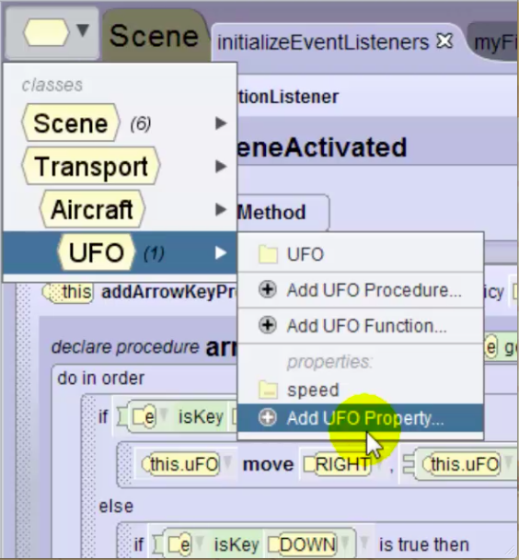
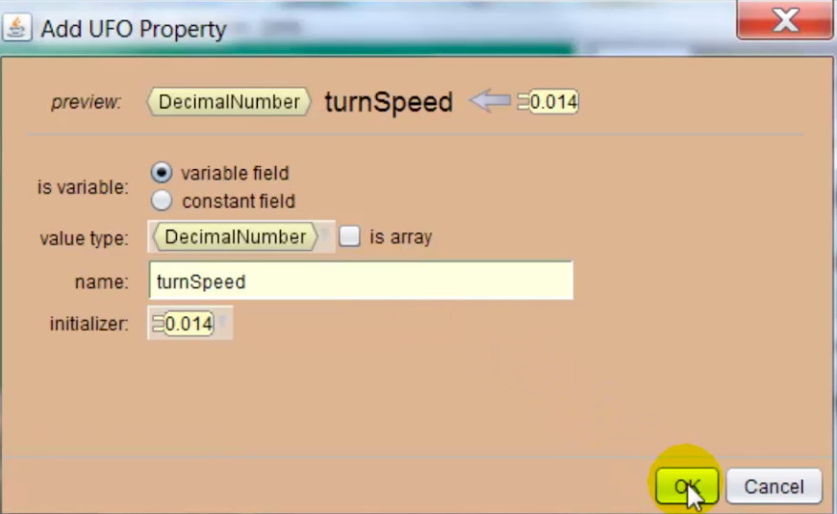
Step 4: User Control of the UFO - Creating Variables
1. Go to the Classes box
2. Select UFO
3. Choose Add UFO Property
4. Create a variable called “turnSpeed” and make it a DecimalValue
5. Set “turnSpeed” to “0.014”

Slide 12
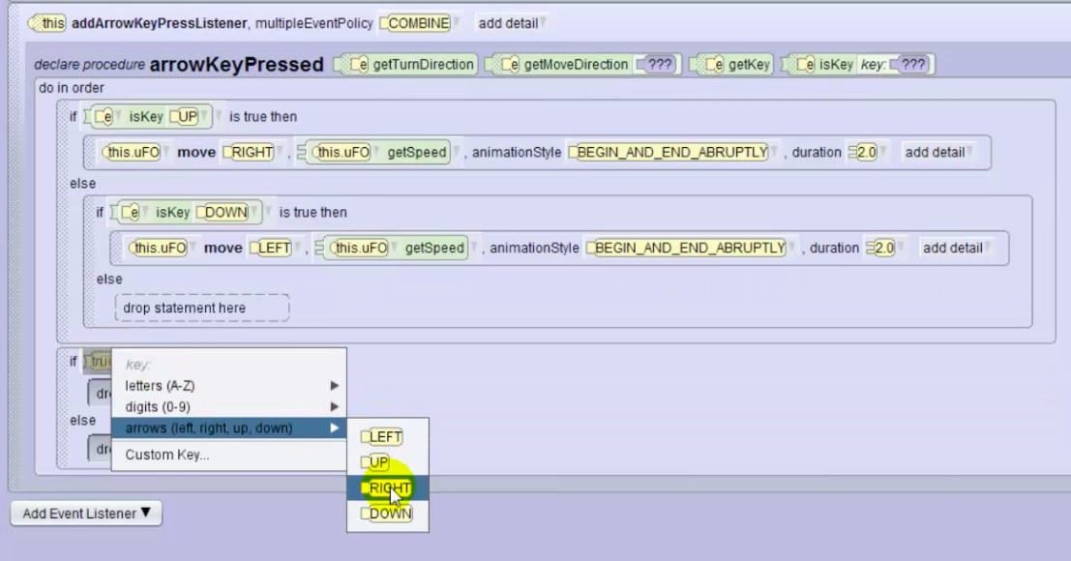
Step 4: User Control of the UFO - Conditional Statements (Using Input to Turn Right)
1. Drag an if statement to arrowKeyPressedListener and set it to true
2. Choose isKey from arrowKeyPressedListener
3. Select arrows
4. Select RIGHT

Slide 13
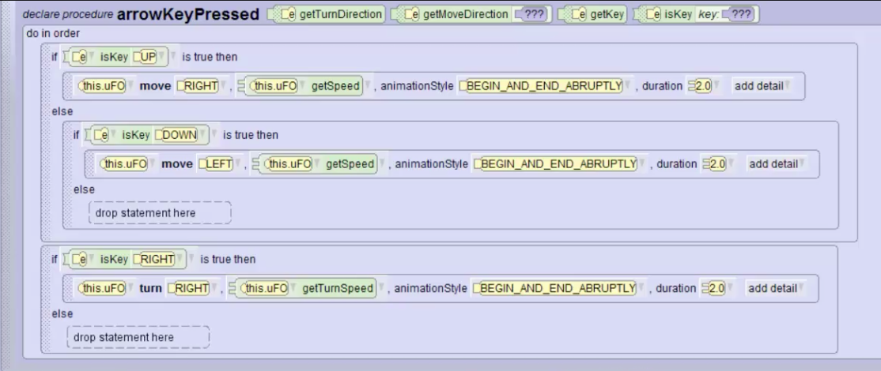
Step 4: User Control of the UFO - Conditional Statements (Using Input to Turn Right
5. Go to this.UFO’s procedures
6. Drag the turn procedure onto drop statement here under isKey
7. Set it to RIGHT
8. Drag this.UFO’s getTurnSpeed function onto the turn procedure’s speed value
9. Click on the turn procedure’s details
10. Go to animation style and choose begin and end abruptly
11. Go to move’s details again
12. Choose duration, then 2.0

Slide 14
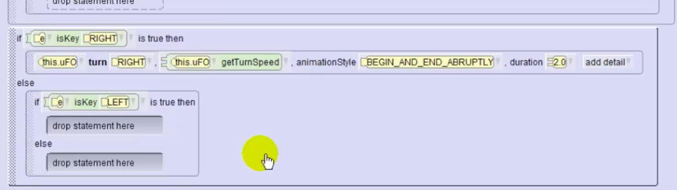
Step 4: User Control of the UFO - Conditional Statements (Using Input to Turn Left)
Repeat Conditional Statements (Using Input to Turn Right) steps with the following changes:
-use LEFT arrow key for isKey event listener
-tell turn procedure to turn LEFT

Slide 15
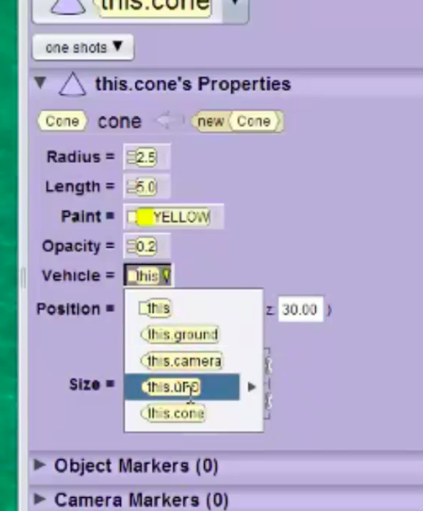
Step 5: Adding the Tractor Beam
1. Click Setup Scene
2. Select the Shapes and Text folder
3. Click the cone
4. Unlink the cone’s size
5. Set width = “5”, height = “5”,
and depth = “5”
6. Set X = “0”, Y = “0”, and Z = “30”
7. Change the cone’s color to “yellow”
8. Set opacity = “0.2”
9. Click Edit Code
10. Click the Vehicle button
11. Select this.UFO

Slide 16
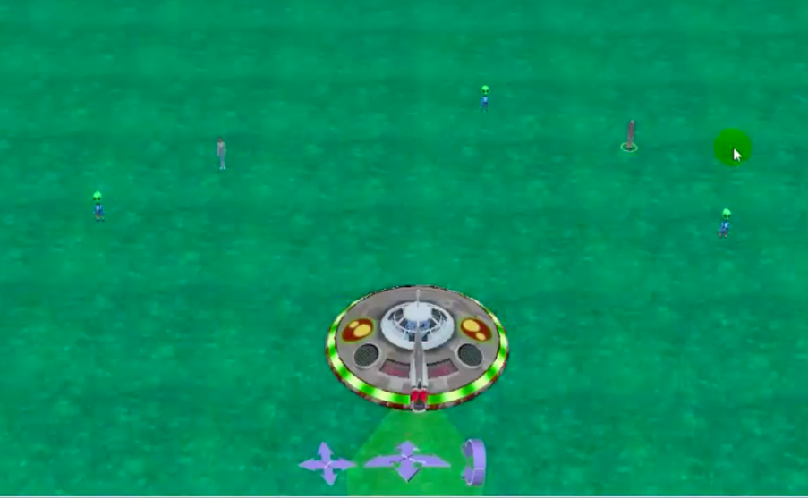
Step 6: Adding People & Aliens to the Scene
1. Click the Biped class
2. Click and drag 3 aliens into the scene named “alien0”, “alien1”, and “alien2”
3. Add at least 5 humans to the scene

Slide 17
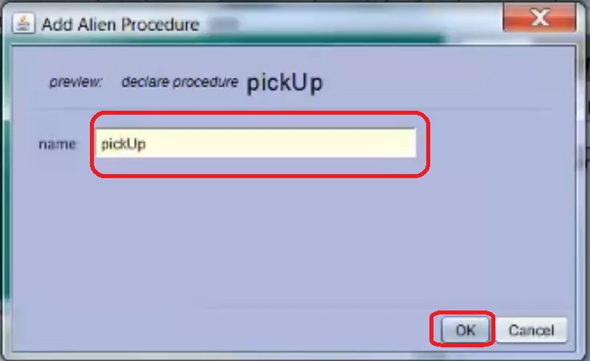
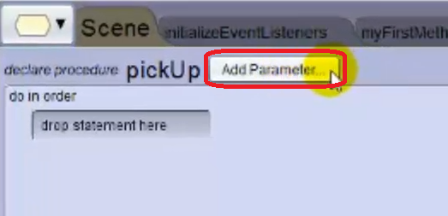
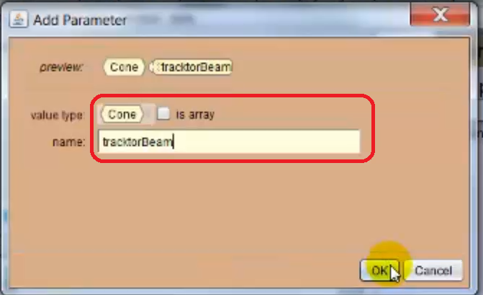
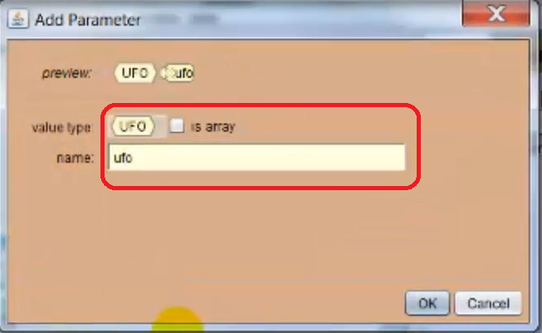
Step 7: Programming the Tractor Beam - Procedures
1. Click the Classes button
2. Select alien
3. Select Add Alien Procedure
4. Name the procedure “pickUp”
5. Select OK
6. Click Add Parameter
7. Set parameter type to UFO
8. Name parameter “ufo”
9. Add another parameter
10. Set it’s type to Cone
11. Name it “tractorBeam”

Slide 18
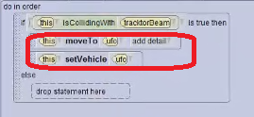
Step 7: Programming the Tractor Beam - Conditional Statements (Checking Collision)
1. Create an if statement
2. Go to functions tab
3. Drag isCollidingWith function onto the if statement
4. Set to collide with tractorBeam
5. Go back to alien’s procedures
6. Place moveTo under the if statement
7. Set it to move to ufo
8. Drag setVehicle procedure under moveTo
9. Set “ufo” as vehicle of “this”

Slide 19
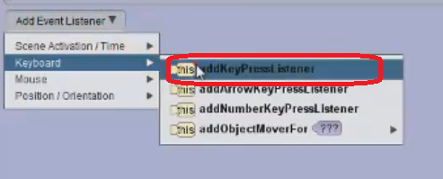
Step 7: Programming the Tractor Beam - Event Listeners
1. Click initializeEventListeners procedure tab
2. Click Add Event Listener
3. Create a Key Pressed listener

Slide 20
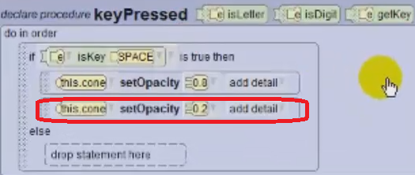
Step 7: Programming the Tractor Beam - Conditional Statements (Using Input for Opacity)
1. Add an if statement to the listener code
2. Click & drag isKey
3. Select keyboard
4. Select space
5. Find this.cone
6. Click & drag setOpacity procedure under the if statement
7. Set value to “0.8”
8. Place another setOpacity procedure under the current setOpacity procedure
9. Set value to “0.2”

Slide 21
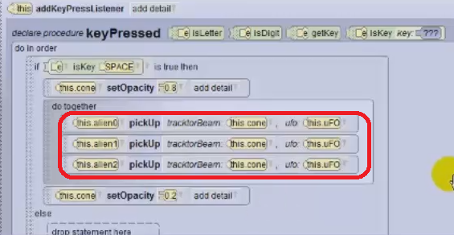
Step 7: Programming the Tractor Beam - Calling a Procedure
1. Add a do together command under the current if statement
2. Find this.alien0 in objects list
3. Click & drag pickUp procedure into do together
4. Set parameters to cone and UFO
5. Repeat for alien1 and alien2

Slide 22
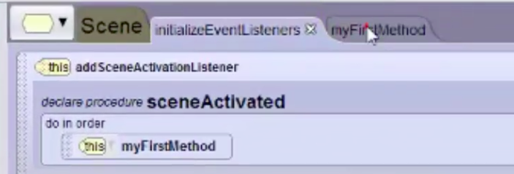
Step 8: Finishing the Game - Editing a Procedure
1. Click the Edit Code button
2. Click the Scene tab
3. Click My First Method to bring up the tab

Slide 23
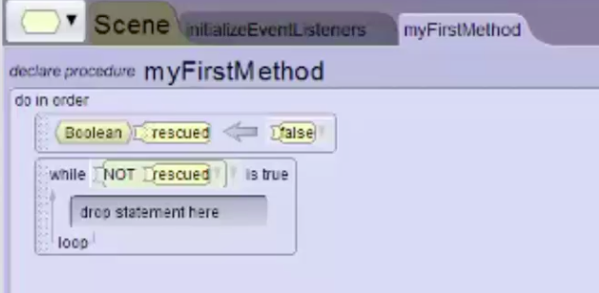
Step 8: Finishing the Game - Editing a Procedure
1. Add a variable and set it as a boolean
2. Name the variable “rescued”
3. Set it to false
4. Add a while loop and set it to “while not rescued”

Slide 24
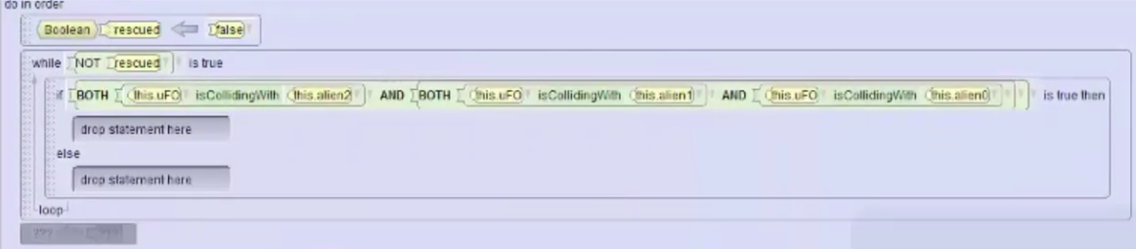
Step 8: Finishing the Game - Creating the Win Condition
1. Add an if statement into the while loop
2. Click on true in the if statement
3. Mouse down to BOTH true and ??? and select true again
4. Select true one other time to get 3 booleans
5. Go to the UFO’s functions tab and drag isCollidingWith onto one of the true booleans.
6. Set this to check collision with alien0
7. Drag isCollidingWith statements to the other true booleans and set them to check collision with alien1 and alien2

Slide 25
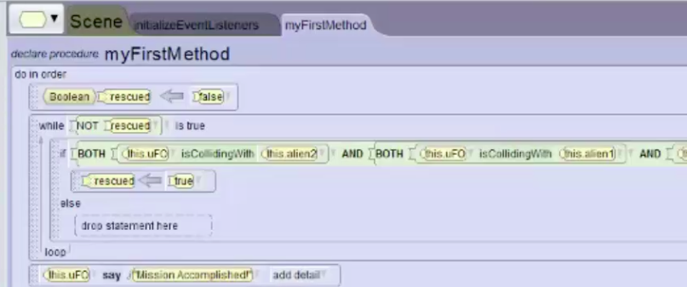
Step 8: Finishing the Game - Creating the Win Condition
8. Drag an assign statement into the if statement
9. Set isRescued to true
10. Drag the say procedure from the UFO’s procedure list after the while statement
11. Tell the UFO to say “Mission Accomplished”
12. You’ve finished building your game! Run the scene to try it out!

