Slide 1
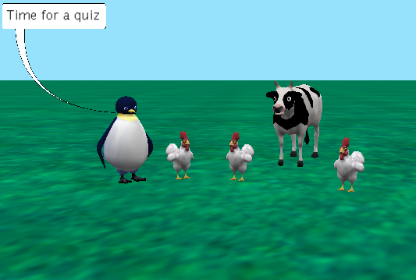
A Simple Quiz for Alice 3.2:
Ask User Functions.
By Lana Dyck
under the direction of Professor Susan Rodger
Duke University
June 2009, added Part 2 July 2011,
Edited for Alice 3 use and Part 3,4 added by Anh Trinh July 2016

Slide 2
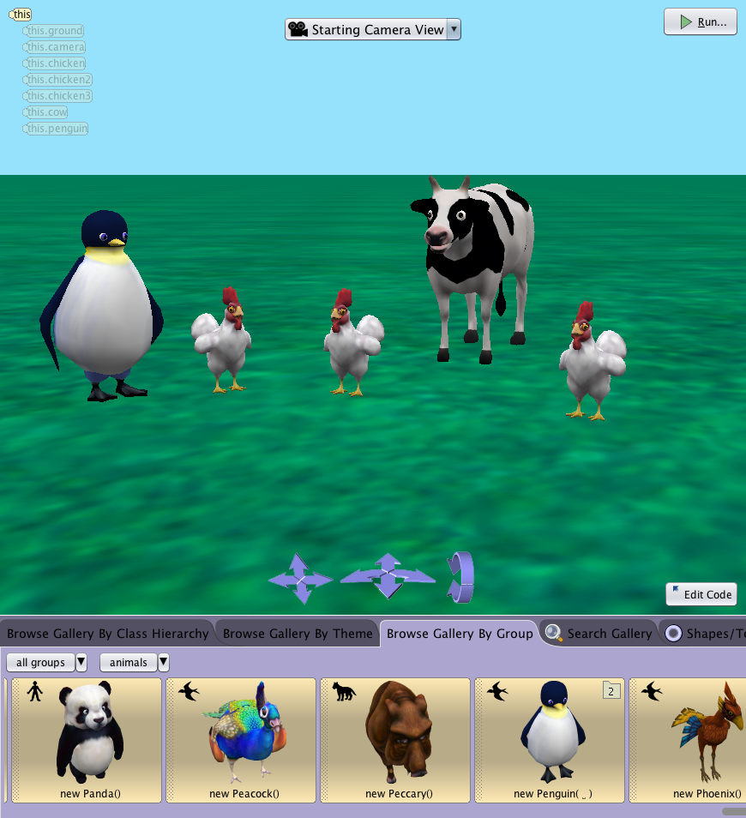
Introduction and Set-up
This tutorial will demonstrate how to create a simple quiz using the three different kinds of “ask user” functions: ask user for a number, ask user for true or false and ask user for a string.
Let's get started by setting up the world.
Open a new Alice grass world.
Click on Setup Scene.
Choose Browse Gallery By Group, and click Animals.
Add one Penguin, one Cow, and three Chickens into your world.
Arrange and resize the objects so they are easy to see.
Click Edit Code when finished.

Slide 3
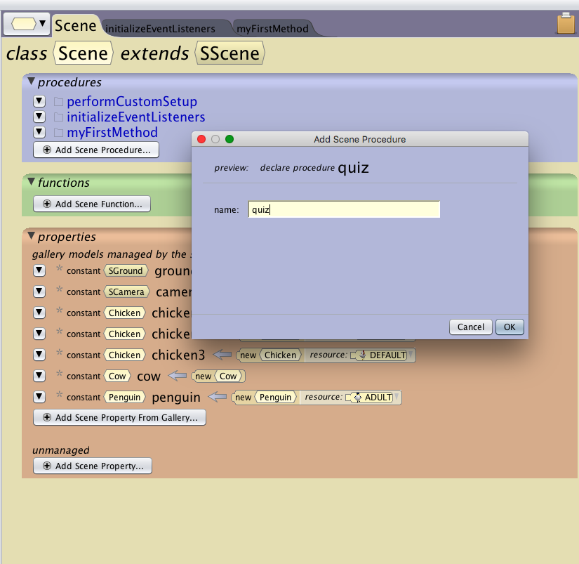
Step 1: Create the Quiz Procedure
Create a new scene procedure that we will use later to hold the instructions for the quiz.
Lets start by creating a quiz procedure
Click on the Scene tab and choose Add Scene Procedure
Name the new procedure: quiz.
Click back on myFirstMethod.

Slide 4
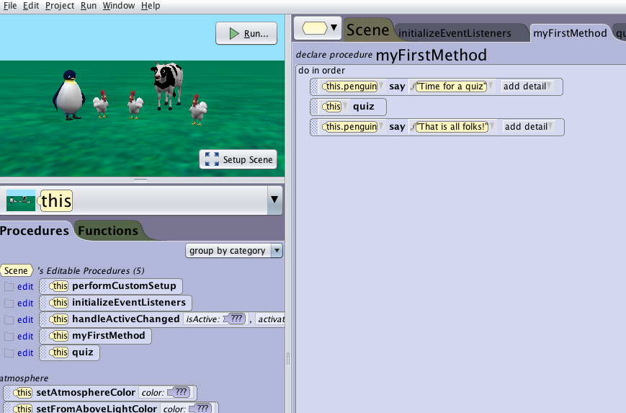
Step 2: Set Up MyFirstMethod
Now we will add the quiz to MyFirstMethod.
Make sure you are in MyFirstMethod.
Click on this.penguin in the object tree.
Drag the say procedure into the procedure editor and type in:
Time for a quiz.
Drag in a second say procedure and type in: That is all folks!
Click on this in the object tree and drag the quiz procedure in between the two penguin say commands

Slide 5
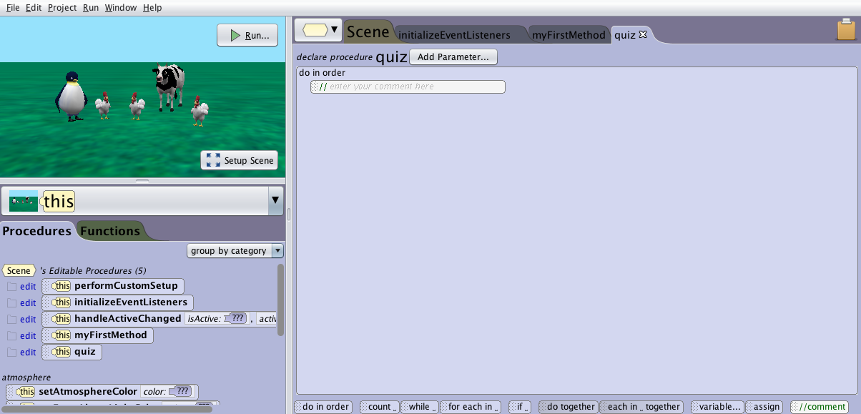
Step 3: Comments
Now we will start writing the quiz procedure. To make our code easier to read we will add in comments. Comments make it possible to add in notes about the code like, what it will do, or who wrote the code.
First click on the quiz procedure tab.
To add a comment drag and drop the double slash button into the method

Slide 6
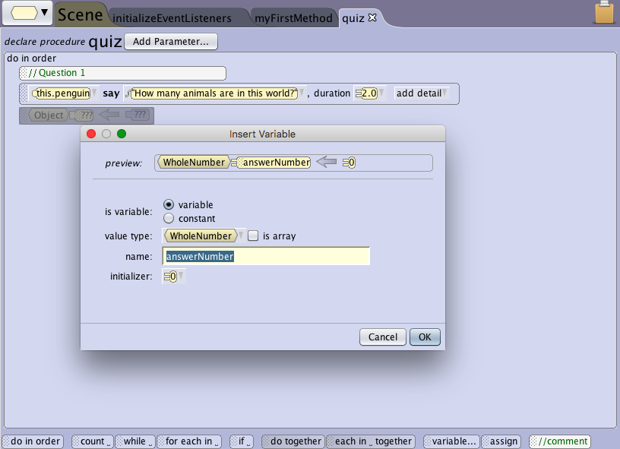
Step 4: Question #1
Type in the comment editor: Question 1
Click on this.penguin in the object tree, have it say: How many animals in the world? and set the duration to 2 seconds.
We need a variable to store the number information we get from the user.
Drag in the button to open variable option box.
Name it answerNumber.
Select WholeNumber beside value type, initialize it to 0 and click OK.

Slide 7
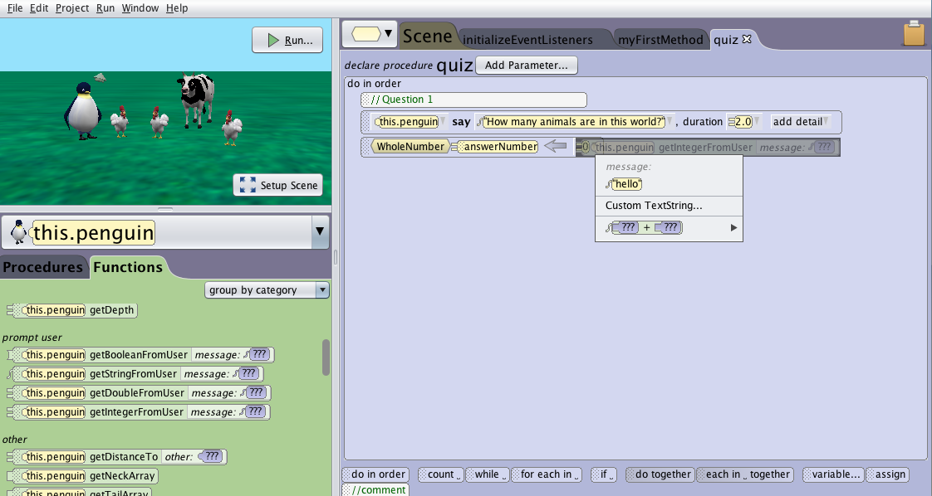
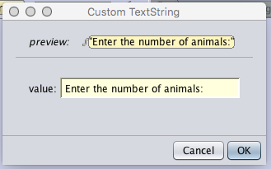
Step 4: Question #1
Continued...
Click on the world in the object tree.
Under the world's details, functions find “ask user for a number.”
Click and drag the ask user for a number over the 1 and select other...
Enter the string: Enter the number of animals:

Slide 8
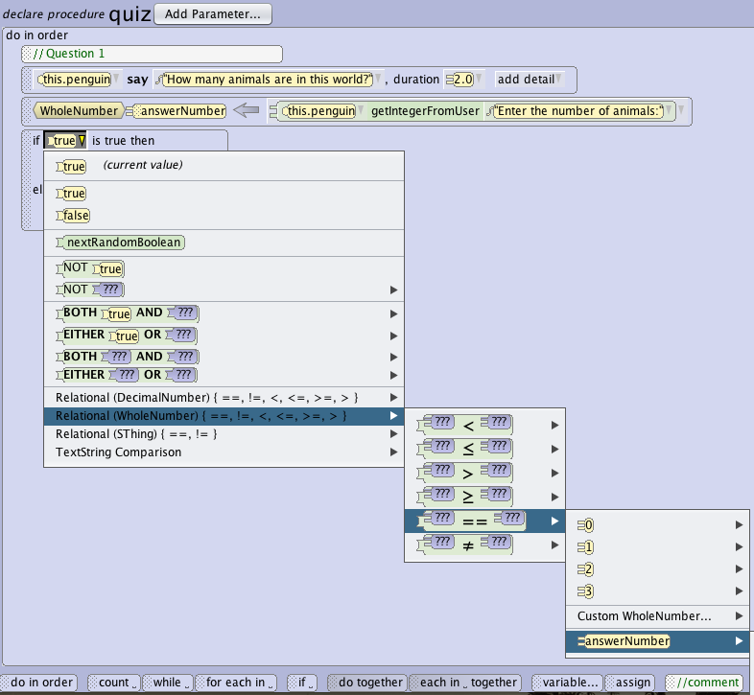
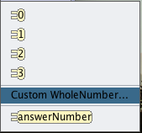
Step 4: Question #1
Continued...
Now we will determine what happens if the answer given is correct or incorrect.
Drag and drop an If block from the bottom of the window and set it to true.
Choose Relational (WholeNumber) in the true drop-down list.
Select “??? == ??? “ -> answerNumber... -> Custom WholeNumber to enter in the value 5.
5 is the correct answer to this question.

Slide 9
Step 4: Question #1
Continued...
For this question when the “If” statement is true, the answer is correct. So we will put our response to the correct answer first.
Click on this.penguin in the object tree.
Under the If:
Drag the say method and type: Correct
Drag the turn method and select 1
When the if statement is false, the answer is incorrect.
Under the Else:
Drag the say method and type: Sorry, that is not correct.
Run your world to take the one question quiz.

Slide 10
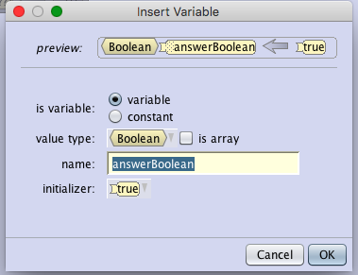
Step 5: Question #2
Now lets make a question that asks the user for a true or false response.
Drop in a comment and type in: Question 2
Click on penguin in the object tree, have it say: Are there more chickens than penguins? and set the duration to 2 seconds.
We need a variable to store the boolean information we get from the user.
Drag in variable button from the bottom of the window .
Name it answerBoolean.
Select Boolean and Click OK.

Slide 11
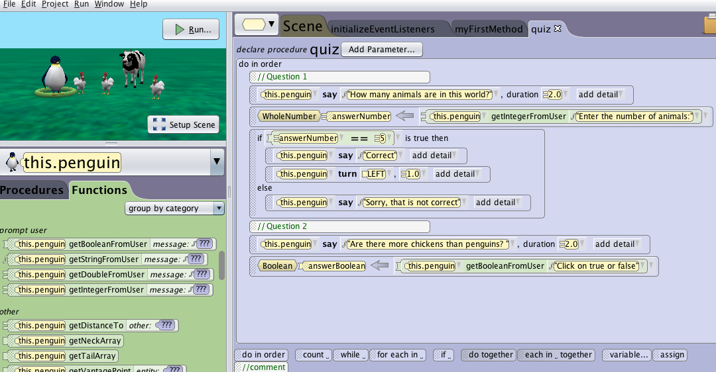
Step 5: Question #2
Continued...
In the penguin's functions, drag and drop the “getBooleanFromUser” over the true.
Type in: Click on true and false.

Slide 12
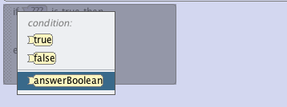
Step 5: Question #2
Continued...
Now we will add in our responses to the answer in another If/Else statement.
Drag and drop an If/Else
statement and select answerBoolean.
The If question accepts just the variable because answerBoolean is a boolean type.

Slide 13
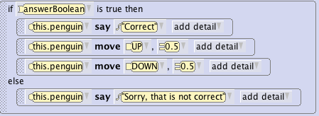
Step 5: Question #2
Continued...
Now complete the question #2 by adding in the procedures as shown below:
Run your world to take the two question quiz.

Slide 14
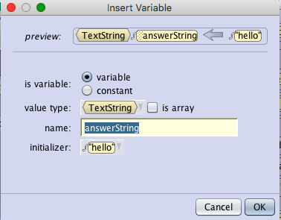
Step 6: Question #3
For our final question we will ask the user to enter a string.
Drop in a comment and type in: Question 3
Click on penguin in the object tree, have it
say: What building are we in? and
set the duration to 2 seconds.
Note: A string is a set of letters or characters. A space is considered a character so be careful if you have a space at the end of your word or sentence.
We need a variable to store the string information we get from the user.
Drag in the variable button.
Name it answerString.
Select TextString and ‘hello’ in initializer
Click OK.

Slide 15
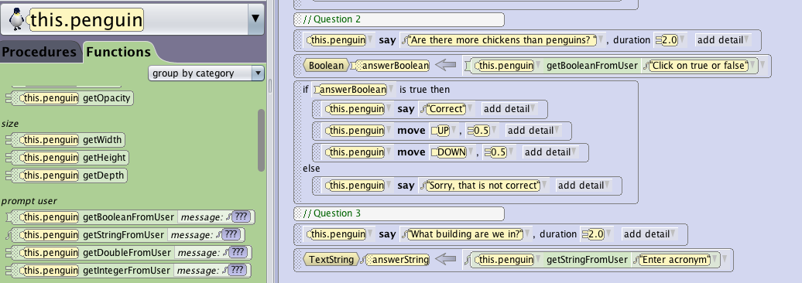
Step 6: Question #3
Continued...
In the penguin's functions,
drag and drop the getStringFromUser over the ‘hello’ string.
Type in: Enter acronym.

Slide 16
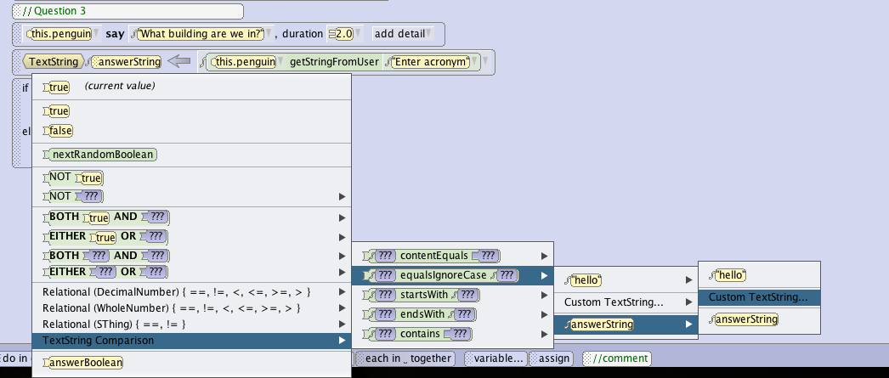
Step 6: Question #3
Continued...
Now we will add in our responses to the answer in another If/Else statement.
Drag and drop an If/Else statement and select true.
Click the down arrow in true and select TextString Comparison -> ???equalsIgnoreCase??? -> answerString -> Custom TextString then type in: LSRC
With equalsIgnoreCase, the answer is not case-sensitive

Slide 17
Step 6: Question #3
Continued...
Click on penguin in the object tree and add in the responses for when the answer is correct or incorrect as shown below.
Now play your world and take the quiz.

Slide 18
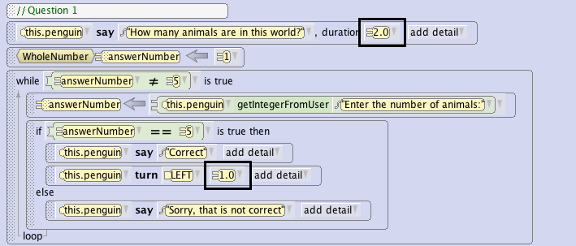
Part 2: Forcing the Answer
In Question 1, if the user mistypes the answer, we want the program to ask the user for the answer again until it is correct.
Rewrite question 1 to add a while loop and force the user into the loop with a wrong value to start with.

Slide 19
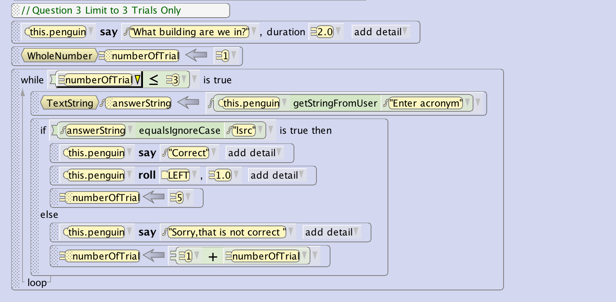
Part 3: Limiting Number of Trials
To limit the number of trials to 3 for example, create a new variable named numberofTrial, create a while loop that allows the question to show up as long as the students tries less than 3 times. Each time they answer incorrectly, increment numberofTrial by 1. If they answer, correctly, set numberofTrial to a number greater than 3 to break out of the while loop ( here we choose 5)

Slide 20
Part 4: Score Reporting
Challenge: To report score to user, we have to create a local variable score for the quiz procedure, initialize it to 0, and increment it by 1 every time the student answer a question correctly. At the end, have the penguin report the score.

Slide 21
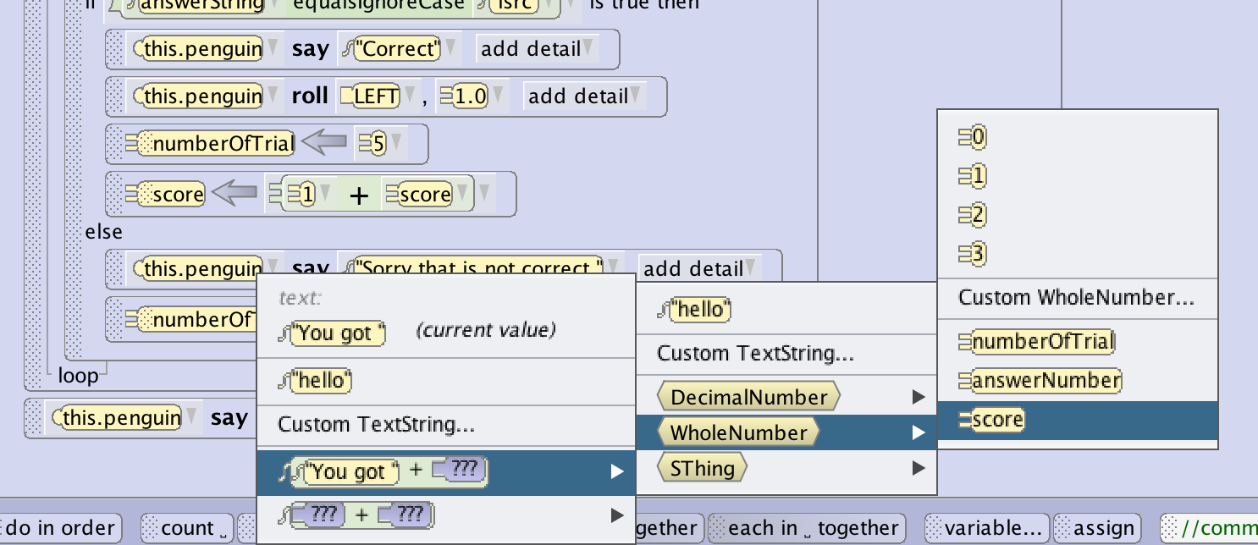
Part 4: Score Reporting
To report the score in the end, drag the penguin say procedure in and type “You got ”.
Click on the down arrow next to the string you just typed and select “You got “+???-> WholeNumber -> score

Slide 22
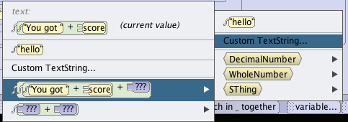
Part 4: Score Reporting
Click on the down arrow next to the “You got “ + score string and select “You got “ + score + ??? -> Custom TextString and Type ” questions correct”

Slide 23
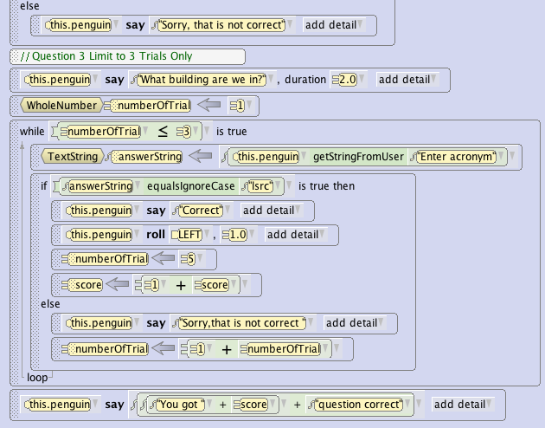
Quiz Procedure code

